Slide 1


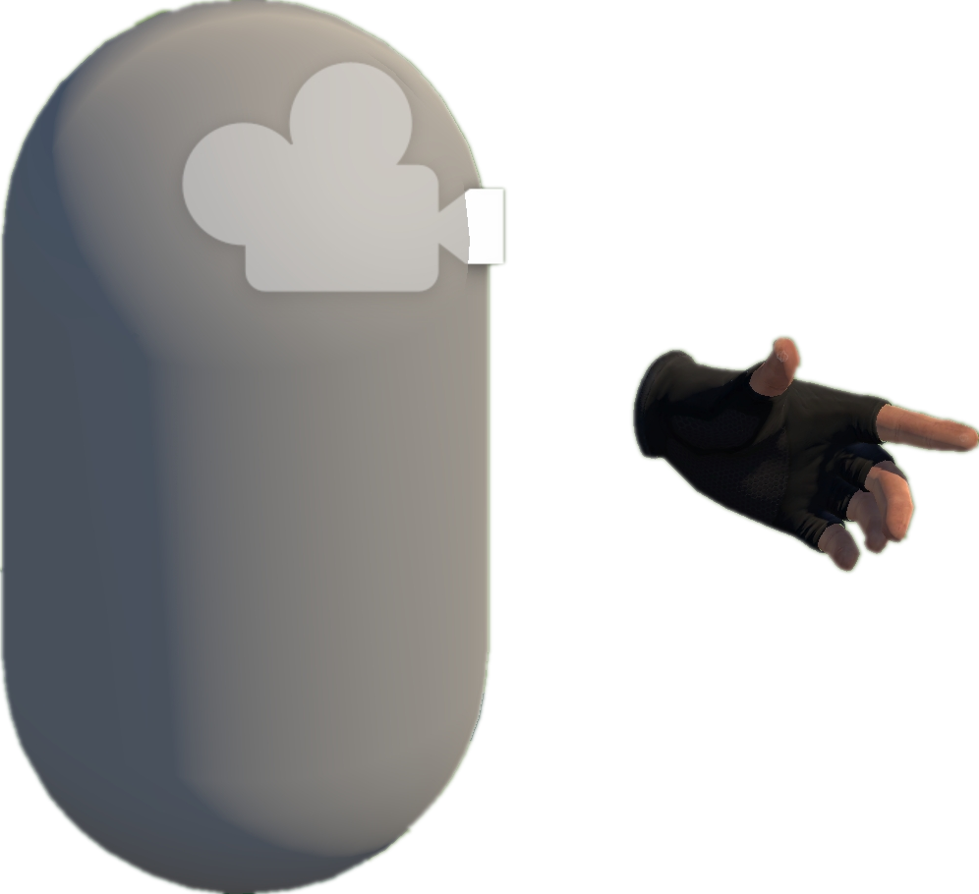
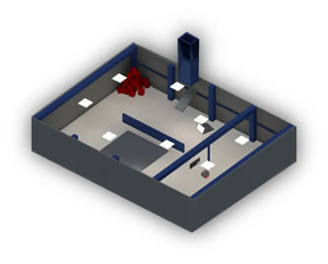
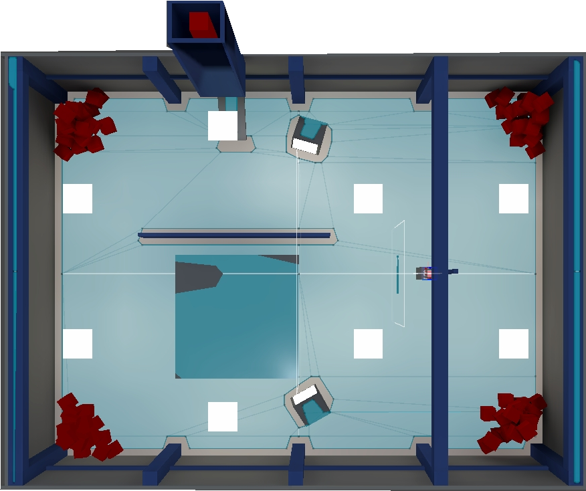







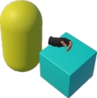
All Scripts
A
Project Collection (§3.2)
E
VRExplorer Test (§3.5)
3
Behavior Execution and Scene Exploration
Preliminary Scene Configuration
Camera
Open Source
Repositories
Tags & Topics
1
Unity-based
Projects
Hand Controller
Bake NavMesh
Collider
Quality Unity
VR Projects
Manifest Validation
& Manual Check
VRExplorer
Original Scene
Scene with NavMesh
Interaction & Scene Analysis
Implementation Interface
Probability-based FSM
Autonomous Event Invocation
All Scripts
2
Project Analysis (§3.2)
Customizing Entity Interface Configuration
B
Hierarchy Analysis
Core Scripts
Decision Making
Environment
Game Logic Code & Third Plugin Analysis
Task Execution
Autonomous
Event Invocation
Task Execution
Interactables
Scripts Implemented
Entity Interface
Box
Input the Next
Interactable’s Mono
Task Generator
EAT Framework (§3.4)
List<BaseAction> GetTask(Mono m);
D
C
Model Abstraction (§3.3)
Task Generator & Customized Task Model
Output Task in the form of List<BaseAction>
Abstraction Object Interaction Feature
Parallel and serial combinations
Grab-And-Drag-Box Task
Move to Approcach
Parallel Action
Triggerable
Base Action
Grab
Move Action
Grab Action
Button, Joystick
Triggerable & Grabbable
Inherit
Move Action
Gun, Cigarette Lighter
Grab Action
Trigger Action
Walk Around
Asynchronous Action
Grabbable
Box, Coin
Grab
Base Entity
Trigger
Abstraction Action
Inherit
Press
Pressing
Trigger Action
+ Triggering Time
+ Triggering() + Triggered()
Pressed
Grabbable Entity
Triggerable Entity
Task Layer
C# Scripts File
Pull
Pulling
Action Layer
Entity Interface
Relaxed
Implement
Fire
Pulling the trigger
Entity Layer
Unity Scene
GameObjects
Triggered
XR Box
XR Joystick
XR Button
Mono Layer
Third Plugin / .dll / Third Assembly
Notes:
单击此处添加文本

